Slide 1

Department of Information Technology
NBA Accredited A.P. Shah Institute of Technology G.B.Road,Kasarvadavli, Thane(W), Mumbai-400615 UNIVERSITY OF MUMBAI Academic Year 2021-2022

Slide 2
A Project Report on Using ML for Facial Mask Detection Submitted in partial fulfillment of the degree of Bachelor of Engineering(Sem-8) in INFORMATION TECHNOLOGY By Harsh Saraiya(18104006) Saloni Rane(18104009) Prajakta Mhaske(18104036) Under the Guidance of Prof. Kiran Deshpande
Prof. Kaushiki Upadhyaya
Prof. Nahid Shaikh

Slide 3
1.Project Conception and Initiation

Slide 4
1.1 Abstract
Effective strategies to restrain COVID-19 pandemic need high attention to mitigate negatively impacted communal health and global economy, with the brim-full horizon yet to unfold.
Since people have become a bit careless towards wearing facial masks outdoors, this system detects the human individual through videos not wearing a mask and informs the authorities about it.
By attaining high precision, real-time detection, and classification, the suggested methodology established its effectiveness in identifying facial masks.

Slide 5
1.2 Objectives
To automate the process of face mask detection using a CCTV camera.
To Classify people into the masked and unmasked category.
Image recognition of unmasked people and notification alert to the Authority about it.
To ensure a safe working environment by creating an atmosphere of awareness & preparedness in the locality.
To enforce the mandate for wearing masks in public places following the COVID-19 pandemic.
To develop an efficient computer-vision based system on the real-time automated monitoring of people to detect face masks in public places.

Slide 6
1.3 Literature Review
Paper | Findings
1. A. S. Joshi, S. S. Joshi, G. Kanahasabai, R. Kapil and S. Gupta, ”Deep Learning Framework to Detect Face Masks from Video Footage,” 2020 12th International Conference on Computational Intelligence and Communication Networks (CICN),2020. | MTCNN(MultiTask Cascaded Convolutional Neural Network)face detection model to identify the faces and their corresponding facial landmarks present in the video frame. MobileNetV2 architecture for the task of identifying faces which are covered by a facial mask.
2. Mamata S.Kalas,“REAL TIME FACE DETECTION AND TRACKING USING OPENCV”, International Journal of Soft Computing And Artificial Intelligence (IJSCAI) , pp. 41-44, Volume-2,Issue-1. | Harr cascade like classifier and adaboost algorithm to track faces on OpenCV platform which is open source and developed by Intel.

Slide 7
Paper | Findings
3. M. M. Rahman, M. M. H. Manik, M. M. Islam, S. Mahmud and J. -H. Kim, ”An Automated System to Limit COVID-19 Using Facial Mask Detection in Smart City Network,”2020. | The learning algorithm Convolutional Neural Network (CNN) is used for feature extraction from the images then these features are learned by multiple hidden layers.
4. S. Abbasi, H. Abdi and A. Ahmadi, ”A Face-Mask Detection Approach based on YOLO Applied for a New Collected Dataset,” 2021 26th International Computer Conference, Computer Society of Iran (CSICC), 2021. | A YOLO face detector spots faces (whether masked or not), and then the faces are classified into masked and unmasked categories.

Slide 8
1.4 Problem Definition
In this phase of covid-19 people are not following proper rules as a precautionary measure.
The pandemic was sudden & the people and governments could not prepare themselves effectively beforehand to mitigate the effects of this pandemic.
The large scale losses that have been noticed across the world due to the covid -19 pandemic have been highly shocking and lead to a lot of loss of property & life.
Though wearing masks is a compulsory action, It is not followed by people.
This virus is highly deadly & has caused multiple casualties which could be prevented through effective preventive measures.

Slide 9
1.5 Scope
To effectively implement image processing approaches for the purpose of face mask detection.
The system is easy to operate and it can be used to implement in public areas.
Use of mask enables effective prevention & further spread of the virus which can be the main ingredient for stopping the infections in their path.
It ensures the compliance for wearing mask and the system provides accurate assessment of the individual in public areas weather the person is wearing mask or not.

Slide 10
1.6 Technology stack
Python3, Jupiter Notebook, Google Colab
OpenCV, TensorFlow, Keras
Firebase, Flutter
Firebase-Admin SDK for Python

Slide 11
1.7 Benefits for environment & Society
To ensure the safety of citizens during the global pandemic.
Use of mask enables effective prevention & further spread of the virus which can be the main ingredient for stopping the infections in their path.
Cost effective system for prevention of covid pandemic.
It will be a user-friendly system where a webcam or CCTV surveillance will record all the time and check to give an alert message.

Slide 12
2. Project Design

Slide 13
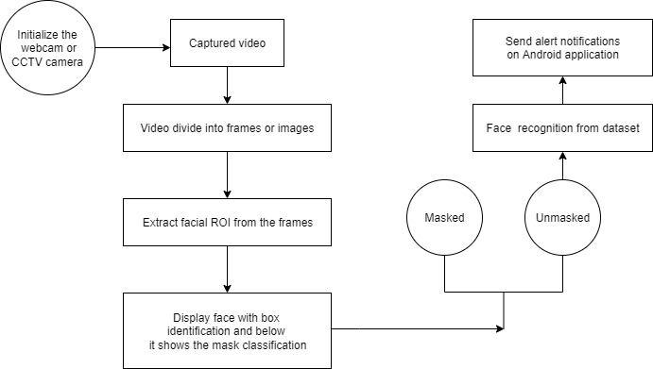
2.1 Proposed System

Slide 14
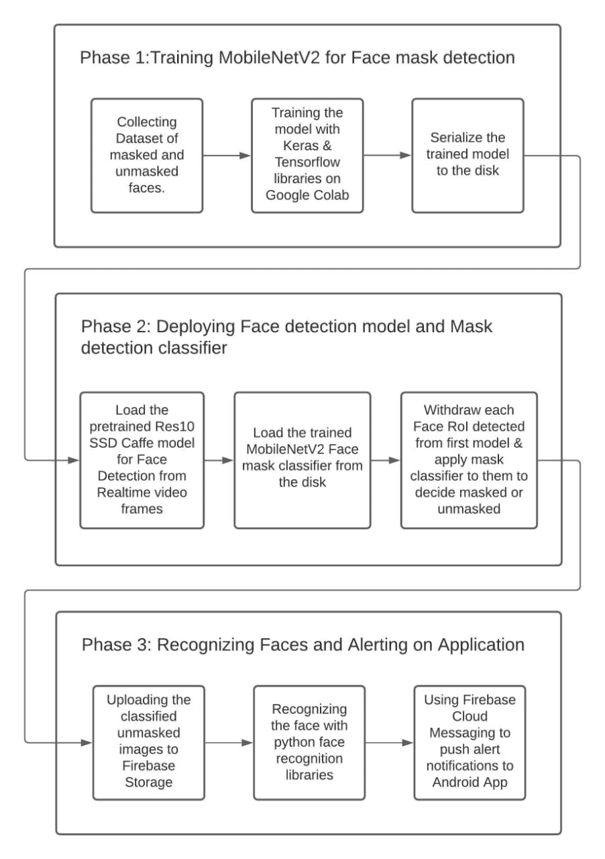
2.2 Design(Flow Of Modules)

Slide 15
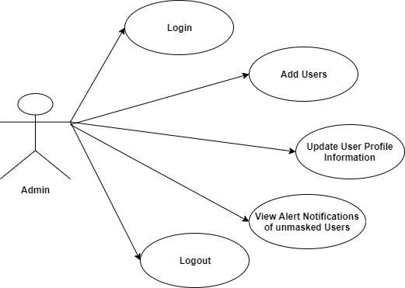
2.3 Use Case of Android Application

Slide 16
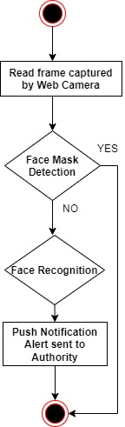
2.4 Activity diagram

Slide 17
3. Implementation

Slide 18
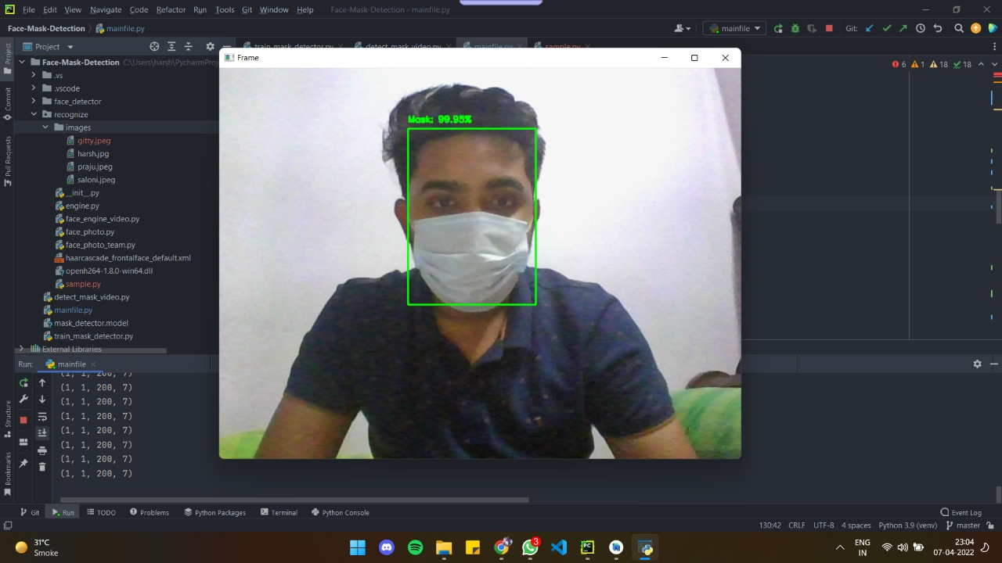
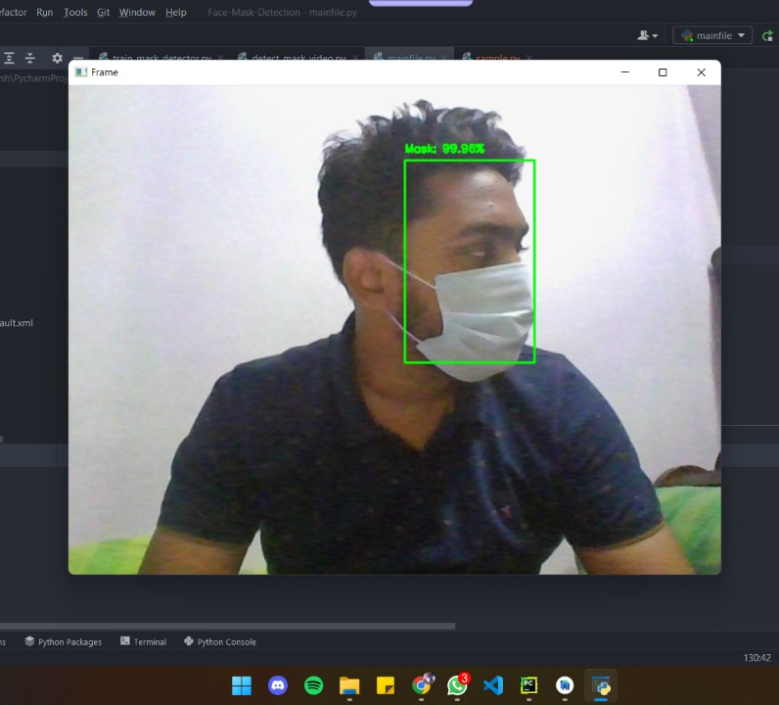

Slide 19
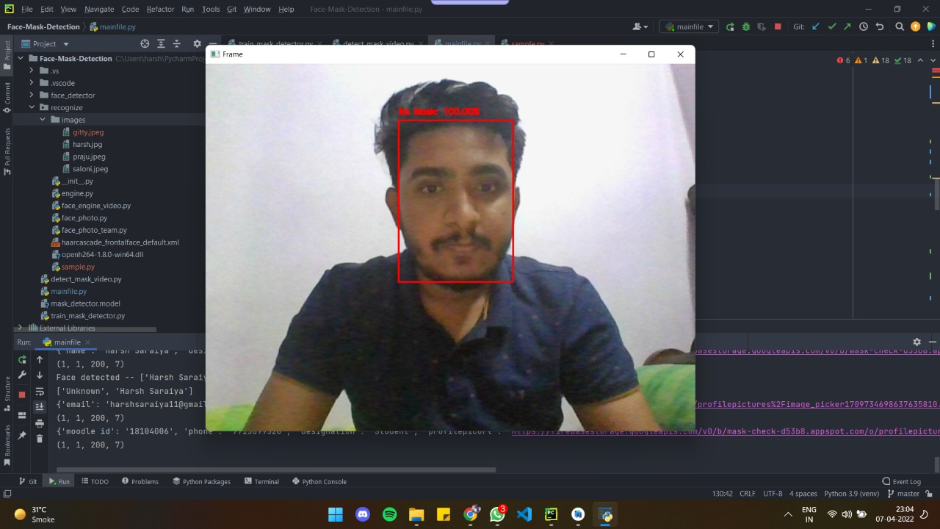

Slide 20



Slide 21



Slide 22
4. Conclusion and Future Scope

Slide 23
Conclusion
To select the base model, we evaluated metrics such as accuracy, precision, recovery and selected the MobileNetV2 architecture with the best performance with 96% accuracy and 99% recall.
A face mask detection architecture is included in the system, which employs a deep learning algorithm to recognize the mask on the user’s face.
This collaborative technique not only aids in reaching high accuracy, but it also significantly improves detection speed.

Slide 24
Future Scope
Can be implemented as mobile application.
Can be used at automatic door opening system in malls and offices.
Can be automated by using drones and robot technology to take action instantly.

Slide 25
References
A. S. Joshi, S. S. Joshi, G. Kanahasabai, R. Kapil and S. Gupta,”Deep Learning Framework to Detect Face Masks from Video Footage,” (CICN), 2020, pp. 435-440, doi: 10.1109/CICN49253.2020.9242625
Mamata S.Kalas,“REAL TIME FACE DETECTION AND TRACKING USING OPENCV”, (IJSCAI) , pp. 41-44, Volume-2,Issue-1.
M. M. Rahman, M. M. H. Manik, M. M. Islam, S. Mahmud and J. -H. Kim, ”An Automated System to Limit COVID-19 Using Facial Mask Detection in Smart City Network,” (IEMTRONICS), 2020, pp. 1-5, doi:10.1109/IEMTRONICS51293.2020.9216386.
S. Abbasi, H. Abdi and A. Ahmadi, ”A Face-Mask Detection Approach based on YOLO Applied for a New Collected Dataset,” (CSICC), 2021, pp. 1-6, doi: 10.1109/CSICC52343.2021.9420599.
Python face-recognition 1.3.0, Recognize and manipulate faces from Python or from the command line with the world’s simplest face recognition library, https://pypi.org/project/face-recognition/

Slide 26
Paper Publication
Paper entitled “USING ML FOR FACIAL MASK DETECTION” is presented at 2022 International Conference for Advancement in Technology (ICONAT 2022) by Harsh Saraiya, Saloni Rane, Prajakta Mhaske, Kiran Deshpande, Kaushiki Upadhyaya, Nahid Shaikh.
Paper entitled “USING ML FOR FACIAL MASK DETECTION” will be submitted at International Journal for Research in Engineering Application & Management (IJRAEM) by Harsh Saraiya, Saloni Rane, Prajakta Mhaske, Kiran Deshpande, Kaushiki Upadhyaya, Nahid Shaikh.

Slide 27
Thank You

